Slide 1
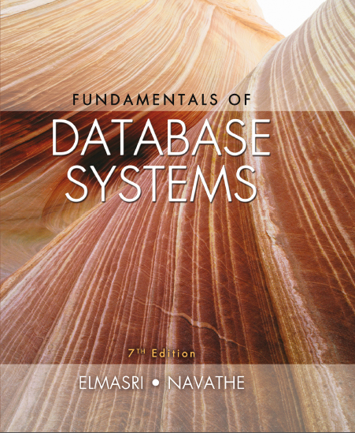
Fundamentals of Database Systems
Seventh Edition
Chapter 30
Database Security
Copyright © 2016, 2011, 2007 Pearson Education, Inc. All Rights Reserved
Notes:
If this PowerPoint presentation contains mathematical equations, you may need to check that your computer has the following installed:
1) MathType Plugin
2) Math Player (free versions available)
3) NVDA Reader (free versions available)

Slide 2
30.1 Introduction to Database Security Issues (1 of 4)
Database security a broad area
Legal, ethical, policy, and system-related issues
Threats to databases
Loss of integrity
Improper modification of information
Loss of availability
Legitimate user cannot access data objects
Loss of confidentiality
Unauthorized disclosure of confidential information

Slide 3
30.1 Introduction to Database Security Issues (2 of 4)
Database works as part of a network of services
Applications, Web servers, firewalls, S S L terminators, and security monitoring systems
Types of database control measures
Access control
Inference control
Flow control
Encryption

Slide 4
30.1 Introduction to Database Security Issues (3 of 4)
Discretionary security mechanisms
Used to grant privileges to users
Mandatory security mechanisms
Classify data and users into various security classes
Implement security policy
Role-based security

Slide 5
30.1 Introduction to Database Security Issues (4 of 4)
Control measures
Access control
Handled by creating user accounts and passwords
Inference control
Must ensure information about individuals cannot be accessed
Flow control
Prevents information from flowing to unauthorized users
Data encryption
Used to protect sensitive transmitted data

Slide 6
Database Security and the D B A
Database administrator (D B A)
Central authority for administering database system
Superuser or system account
D B A-privileged commands
Account creation
Privilege granting
Privilege revocation
Security level assignment

Slide 7
Access Control, User Accounts, and Database Audits
User must log in using assigned username and password
Login session
Sequence of database operations by a certain user
Recorded in system log
Database audit
Reviewing log to examine all accesses and operations applied during a certain time period

Slide 8
Sensitive Data and Types of Disclosures (1 of 3)
Sensitivity of data
Inherently sensitive
From a sensitive source
Declared sensitive
A sensitive attribute or sensitive record
Sensitivity in relation to previously disclosed data

Slide 9
Sensitive Data and Types of Disclosures (2 of 3)
Factors in deciding whether it is safe to reveal the data
Data availability
Not available when being updated
Access acceptability
Authorized users
Authenticity assurance
External characteristics of the user
Example: access only allowed during working hours

Slide 10
Sensitive Data and Types of Disclosures (3 of 3)
Typically a tradeoff between precision and security
Precision
Protect all sensitive data while making available as much nonsensitive data as possible
Security
Ensuring data kept safe from corruption and access suitably controlled

Slide 11
Relationship Between Information Security and Information Privacy
Concept of privacy goes beyond security
Ability of individuals to control the terms under which their personal information is acquired and used
Security a required building block for privacy
Preventing storage of personal information
Ensuring appropriate use of personal information
Trust relates to both security and privacy

Slide 12
30.2 Discretionary Access Control Based on Granting and Revoking Privileges (1 of 2)
Two levels for assigning privileges to use a database system
Account level
Example: CREATE SCHEMA or CREATE TABLE privilege
Not defined for S Q L2
Relation (or table) level
Defined for S Q L2
Access matrix model

Slide 13
30.2 Discretionary Access Control Based on Granting and Revoking Privileges (2 of 2)
Each relation R assigned an owner account
Owner of a relation given all privileges on that relation
Owner can grant privileges to other users on any owned relation
SELECT (retrieval or read) privilege on R
Modification privilege on R
References privilege on R

Slide 14
Specifying Privileges Through the Use of Views
Consider owner A of relation R and other party B
A can create view V of R that includes only attributes A wants B to access
Grant SELECT on V to B
Can define the view with a query that selects only those tuples from R that A wants B to access

Slide 15
Revocation and Propagation of Privileges (1 of 2)
Revoking of Privileges
Useful for granting a privilege temporarily
REVOKE command used to cancel a privilege
Propagation of privileges using the GRANT OPTION
If GRANT OPTION is given, B can grant privilege to other accounts
D B M S must keep track of how privileges were granted if D B M S allows propagation

Slide 16
Revocation and Propagation of Privileges (2 of 2)
Horizontal and vertical propagation limits
Limiting horizontal propagation to an integer number i
Account B given the GRANT OPTION can grant the privilege to at most i other accounts
Vertical propagation limits the depth of the granting of privileges
Not available currently in S Q L or other relational systems

Slide 17
30.3 Mandatory Access Control and Role-Based Access Control for Multilevel Security (1 of 2)
Mandatory access control
Additional security policy that classifies data and users based on security classes
Typical security classes
Top secret
Secret
Confidential
Unclassified
Bell-LaPadula model
Subject and object classifications

Slide 18
30.3 Mandatory Access Control and Role-Based Access Control for Multilevel Security (2 of 2)
Simple security property
Subject S not allowed read access to object O unless
Star property
Subject not allowed to write an object unless
Prevent information from flowing from higher to lower classifications
Attribute values and tuples considered as data objects

Slide 19
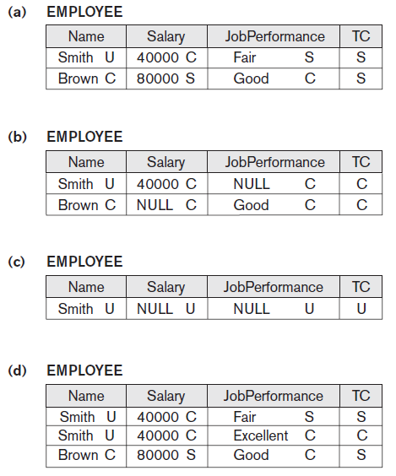
Figure 30.2 A Multilevel Relation to Illustrate Multilevel Security
(a) The original EMPLOYEE tuples (b) Appearance of EMPLOYEE after filtering for classification C users (c) Appearance of EMPLOYEE after filtering for classification U users (d) Polyinstantiation of the Smith tuple

Slide 20
Comparing Discretionary Access Control and Mandatory Access Control
D A C policies have a high degree of flexibility
Do not impose control on how information is propagated
Mandatory policies ensure high degree of protection
Rigid
Prevent illegal information flow

Slide 21
Role-Based Access Control
Permissions associated with organizational roles
Users are assigned to appropriate roles
Can be used with traditional discretionary and mandatory access control
Mutual exclusion of roles
Authorization time exclusion
Runtime exclusion
Identity management

Slide 22
Label-Based Security and Row-Level Access Control
Sophisticated access control rules implemented by considering the data row by row
Each row given a label
Used to prevent unauthorized users from viewing or altering certain data
Provides finer granularity of data security
Label security policy
Defined by an administrator

Slide 23
X M L Access Control
Digital signatures for X M L
X M L Signature Syntax and Processing specification
Defines mechanisms for countersigning and transformations
X M L encryption
X M L Encryption Syntax and Processing specification
Defines X M L vocabulary and processing rules

Slide 24
Access Control Policies for the Web and Mobile Applications
E-commerce environments require elaborate access control policies
Go beyond traditional D B M Ss
Legal and financial consequences for unauthorized data breach
Content-based access control
Takes protection object content into account
Credentials

Slide 25
30.4 S Q L Injection
S Q L injection
Most common threat to database system
Other common threats
Unauthorized privilege escalation
Privilege abuse
Denial of service
Weak authentication

Slide 26
S Q L Injection Methods (1 of 2)
Attacker injects a string input through the application
Changes or manipulates S Q L statement to attacker’s advantage
Unauthorized data manipulation or execution of system-level commands
S Q L manipulation
Changes an S Q L command in the application
Example: adding conditions to the WHERE clause

Slide 27
S Q L Injection Methods (2 of 2)
Typical manipulation attack occurs during database login
Code injection
Add additional S Q L statements or commands that are then processed
Function call injection
Database or operating system function call inserted into vulnerable S Q L statement to manipulate data or make a privileged system call

Slide 28
Risks Associated with S Q L Injection
Database fingerprinting
Denial of service
Bypassing authentication
Identifying injectable parameters
Executing remote commands
Performing privilege escalation

Slide 29
Protection Techniques
Blind variables (using parameterized statements)
Protects against injection attacks
Improves performance
Filtering input (input validation)
Remove escape characters from input strings
Escape characters can be used to inject manipulation attacks
Function security
Standard and custom functions should be restricted

Slide 30

30.5 Introduction to Statistical Database Security (1 of 2)
Statistical databases used to provide statistics about various populations
Users permitted to retrieve statistical information
Must prohibit retrieval of individual data
Population: set of tuples of a relation (table) that satisfy some selection condition
Figure 30.3 The PERSON relation schema for illustrating statistical database security

Slide 31
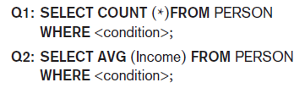
30.5 Introduction to Statistical Database Security (2 of 2)
Only statistical queries are allowed
Preventing the inference of individual information
Provide minimum threshold on number of tuples
Prohibit sequences of queries that refer to the same population of tuples
Introduce slight noise or inaccuracy
Partition the database
Store records in groups of minimum size

Slide 32
30.6 Introduction to Flow Control (1 of 2)
Flow control
Regulates the distribution or flow of information among accessible objects
Verifies information contained in some objects does not flow explicitly or implicitly into less protected objects
Flow policy
Specifies channels along which information is allowed to move
Simple form: confidential and nonconfidential

Slide 33
30.6 Introduction to Flow Control (2 of 2)
Covert channels
Allows information to pass from a higher classification level to a lower classification level through improper means
Timing channel requires temporal synchronization
Storage channel does not require temporal synchronization

Slide 34
30.7 Encryption and Public Key Infrastructures (1 of 3)
Encryption converts data into cyphertext
Performed by applying an encryption algorithm to data using a prespecified encryption key
Resulting data must be decrypted using a decryption key to recover original data
Data Encryption Standard (D E S)
Developed by the U.S. Government for use by the general public
Advanced Encryption Standard (A E S)
More difficult to crack

Slide 35
30.7 Encryption and Public Key Infrastructures (2 of 3)
Symmetric key algorithms
Also called secret key algorithms
Need for sharing the secret key
Can apply some function to a user-supplied password string at both sender and receiver
Public (asymmetric) key encryption
Involves public key and private key
Private key is not transmitted
Two keys related mathematically
Very difficult to derive private key from public key

Slide 36
30.7 Encryption and Public Key Infrastructures (3 of 3)
Public (asymmetric) key encryption steps
Each user generates a pair of keys to be used for encryption and decryption of messages
Each user places public key in a public register or other accessible file
Keeps companion key private
Sender encrypts message using receiver’s public key
Receiver decrypts message using receiver’s private key
R S A public key encryption algorithm

Slide 37
Digital Signatures
Consist of string of symbols
Each is unique
Function of the message it is signing, along with a timestamp
Depends on secret number unique to the signer
Public key techniques used to create digital signatures

Slide 38
Digital Certificates
Combines value of a public key with the identity of the person or service that holds the corresponding private key into a digitally signed statement
Information included in the certificate
Owner information
Public key of the owner
Date of certificate issue and validity period
Issuer identification
Digital signature

Slide 39
30.8 Privacy Issues and Preservation
Growing challenge for database security
Limit performing large-scale mining and analysis
Central warehouses for vital information
Violating security could expose all data
Distributed data mining algorithms
Remove identity information in released data
Inject noise into the data
Must be able to estimate errors introduced
Mobile device privacy

Slide 40
30.9 Challenges to Maintaining Database Security (1 of 2)
Data quality
Quality stamps
Application-level recovery techniques to automatically repair incorrect data
Intellectual property rights
Digital watermarking techniques

Slide 41
30.9 Challenges to Maintaining Database Security (2 of 2)
Database survivability
Confinement
Damage assessment
Reconfiguration
Repair
Fault treatment

Slide 42
30.10 Oracle Label-Based Security
Oracle label security
Enables row-level access control
Every table or view has an associated security policy
Virtual private database (V P D) technology
Feature that adds predicates to user statements to limit their access in a transparent manner to the user and the application
Based on policies

Slide 43
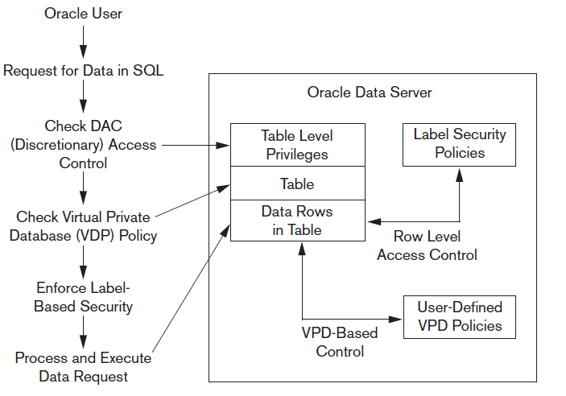
Label Security Architecture
Figure 30.4 Oracle label security architecture. Data from: Oracle (2007)

Slide 44
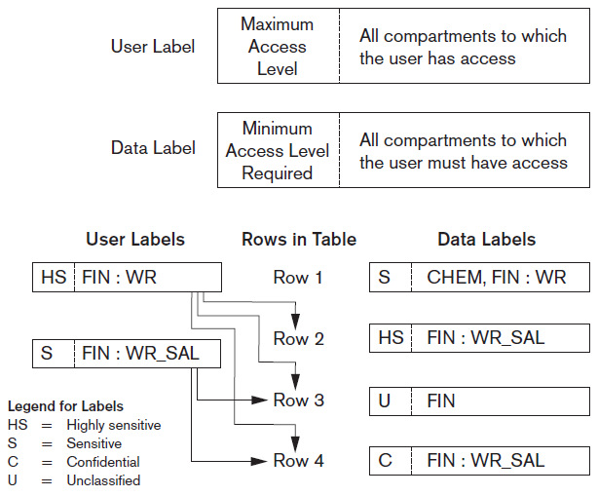
How Data Labels and User Labels Work Together
Figure 30.5 Data labels and user labels in Oracle. Data from: Oracle (2007)

Slide 45
30.11 Summary
Threats to databases
Types of control measures
Access control
Inference control
Flow control
Encryption
Mandatory access control
S Q L injection
Key-based infrastructures

Slide 46

Copyright

